Slide 1
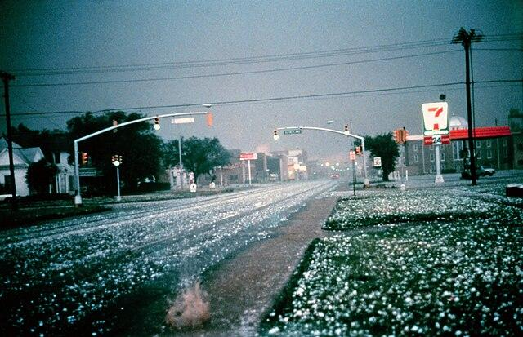
Hail Forecasting

Slide 2
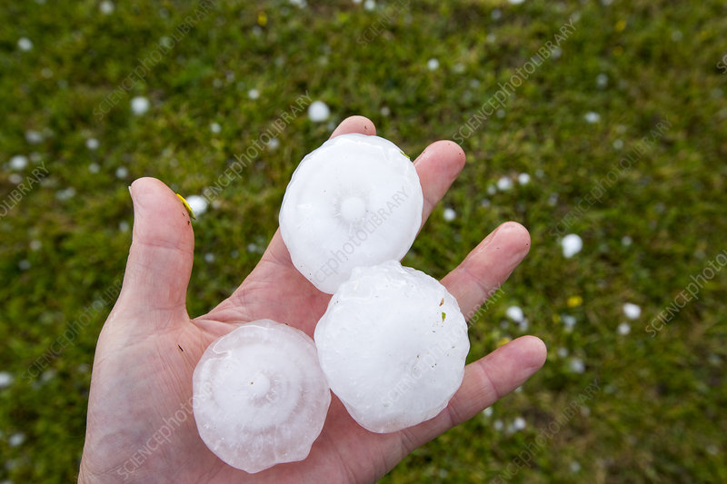
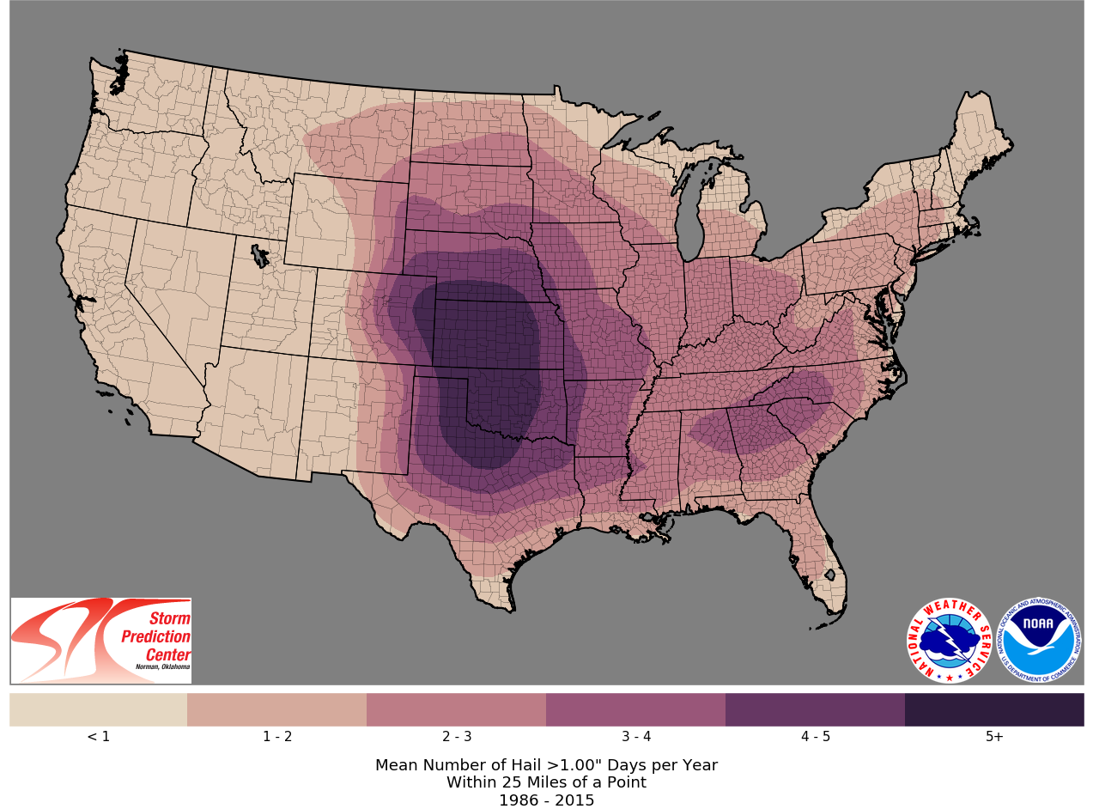
Background
Severe hail is any hail greater than 1” in diameter after 2010.
  Sig Hail > 2” in diameter
  Prior to 2010 it was 0.75”
Around 5,000 Severe hail reports on average in the us every year.
  Numerous cases of sub-severe hail
  Accumulating hail also a growing area of study.
Most common over the Great Plains states
One of the most costly hazards associated with severe thunderstorms
  Billion dollar hail storms becoming more frequent.

Slide 3
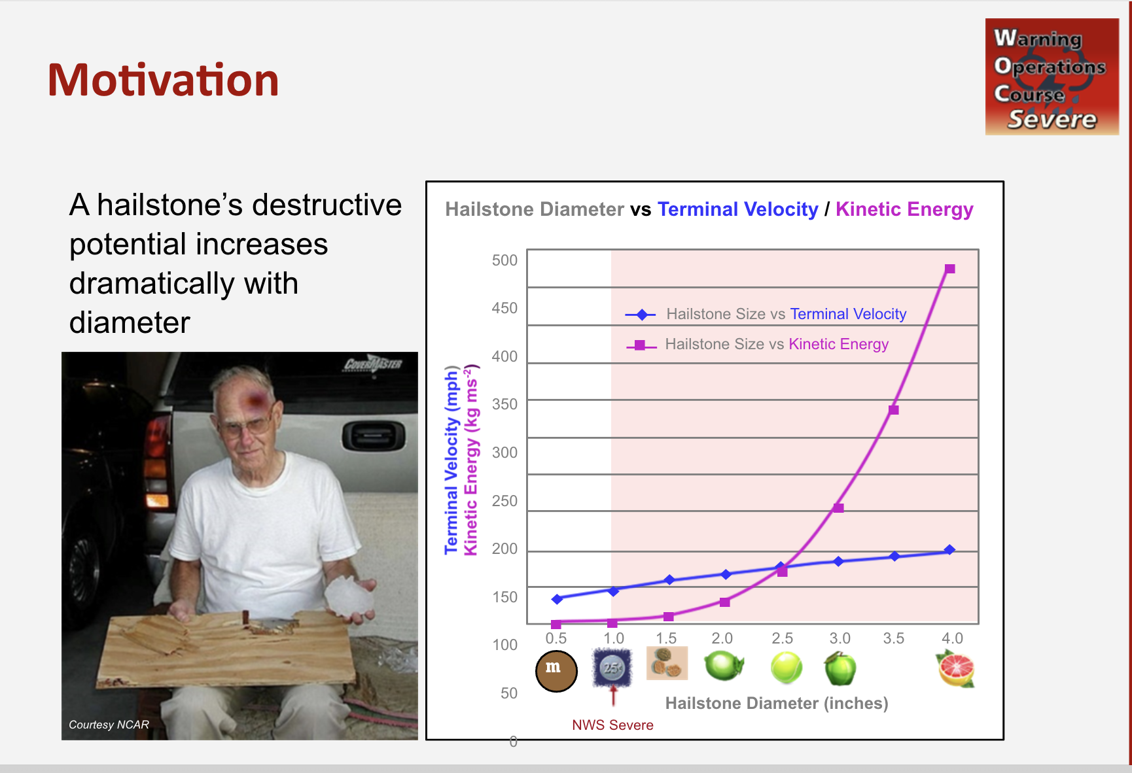

Slide 4
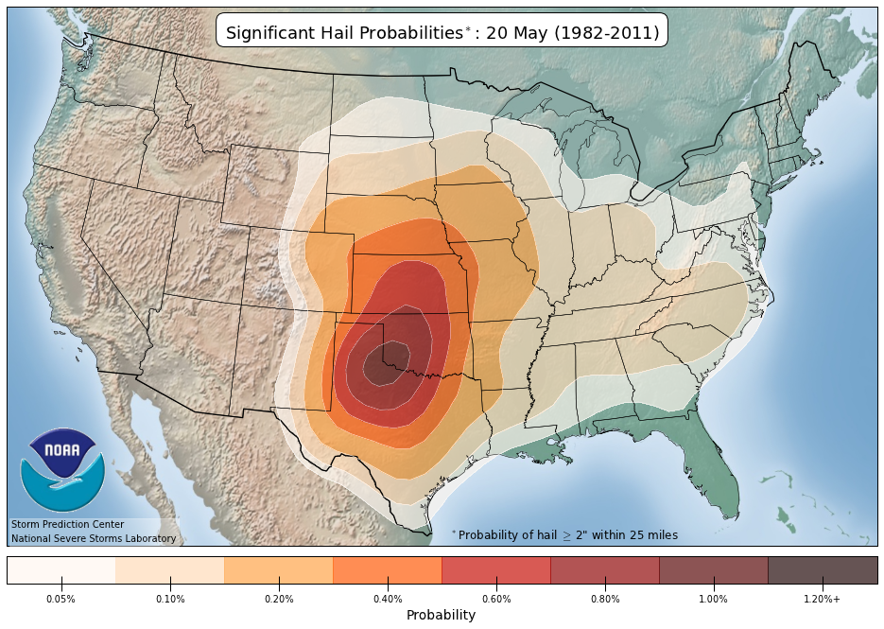
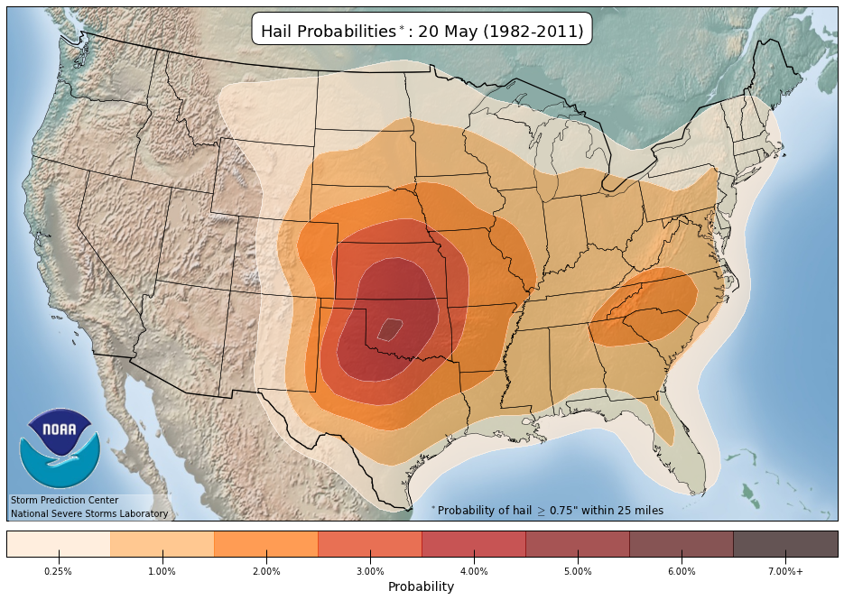
https://www.spc.noaa.gov/new/SVRclimo/climo.php?parm=allHail
https://www.spc.noaa.gov/new/SVRclimo/climo.php?parm=sigHail

Slide 5
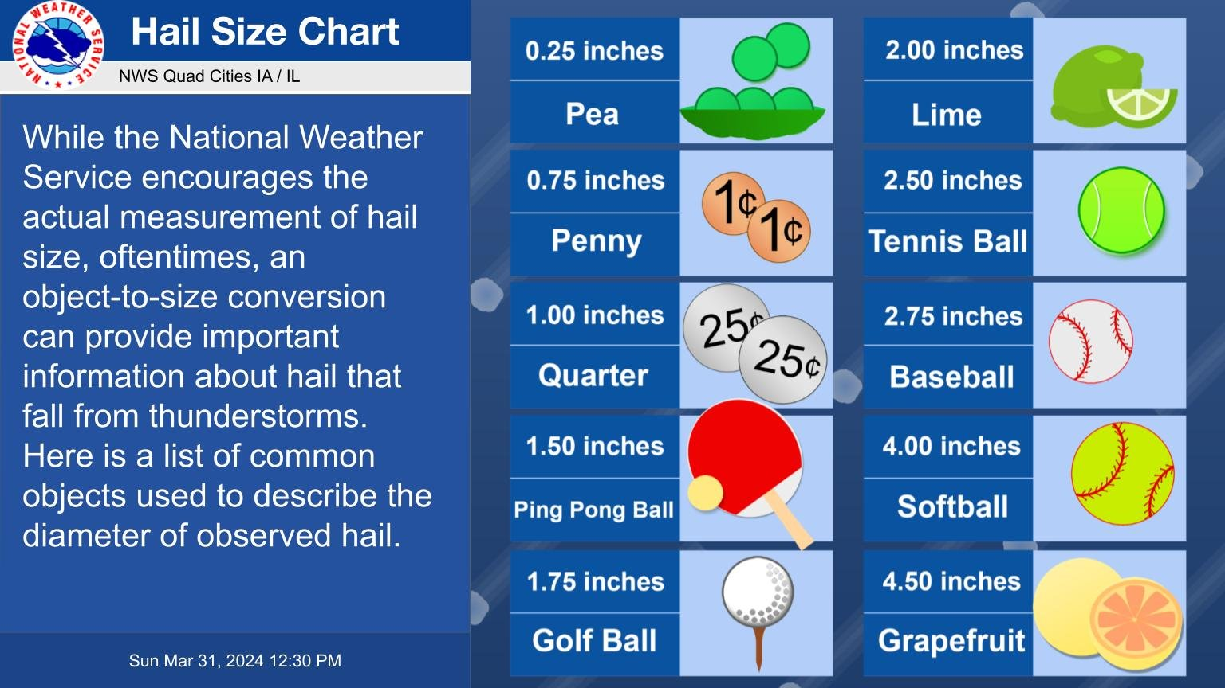

Slide 6
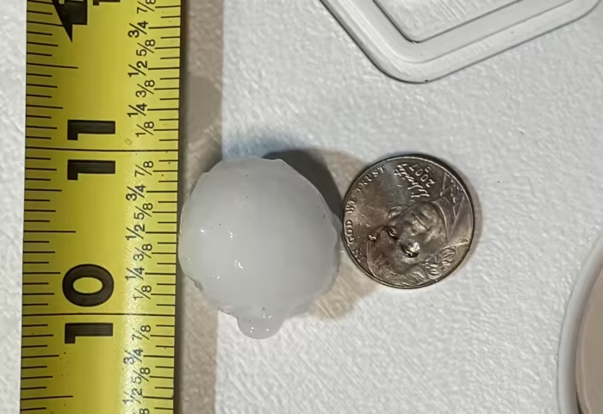
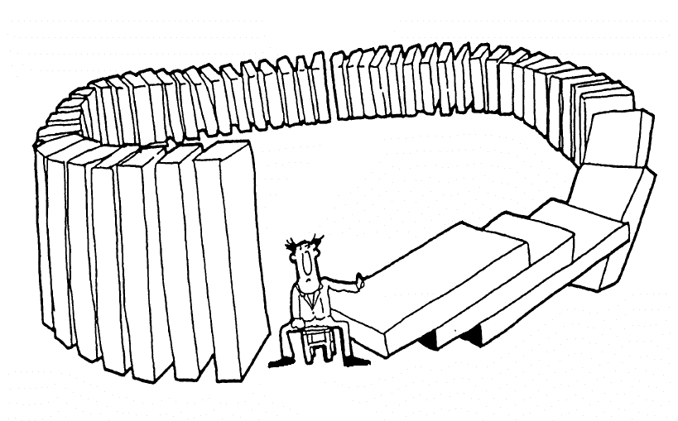
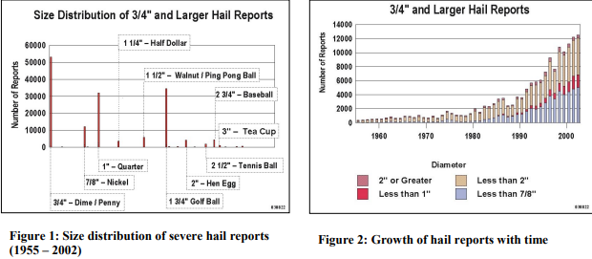
How its messed stuff up…
Size discretization of hail from coins and objects has resulted in unrealistic distributions of reported sizes.
Hail size should generally decrease in frequency (exponential) but we see a multimodal distribution.
Hail size cluster around common objects and sizes
  Quarter
  Golf Ball
  Baseball
It’s gotten much easier to report hail
  MPING
  Spotter network
  Twitter
  but perhaps not the true size…
Schafer et al.,

Slide 7
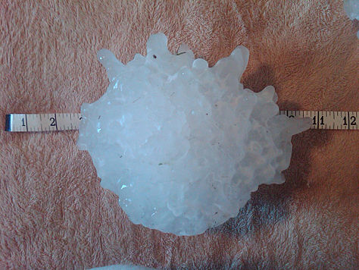
Records
Us record for diameter is from Vivian, SD july 23rd of 2010
  7.9 inches (20 cm) in diameter and weighed nearly 2 lbs.
Heaviest: 1.02 kg (2.2 lb); Gopalganj District, Bangladesh, 14 April 1986.^{[43][44]}
Largest diameter officially measured: 7.9 in (20 cm) diameter, 18.622 in (47.3 cm) circumference; Vivian, South Dakota, 23 July 2010.^{[45]}
Largest circumference officially measured: 18.74 in (47.6 cm) circumference, 7.0 in (17.8 cm) diameter; Aurora, Nebraska, 22 June 2003.^{[44][46]}
Greatest average hail precipitation: Kericho, Kenya experiences hailstorms, on average, 50 days annually.
https://en.wikipedia.org/wiki/File:Record_hailstone_Vivian,_SD.jpg

Slide 8
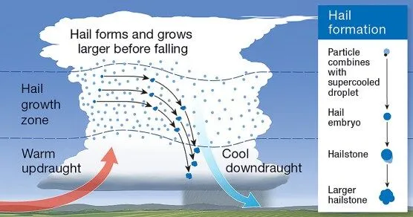
Basics of Hail Formation: Ingredients
Hail requires 3 ingredients.
Hail Embryo
  An ice nuclei that begins the freezing process.
A moderately strong updraft.
  The updraft must be strong enough to suspend large and heavy hailstones, but not too strong to maximize residence time
Moisture or saturation
  Supercooled liquid water (SLW) is required for accretion to build large hailstones.
  As stones grow their terminal velocity increases until it surpass the updraft speed.
  v_t = √( (2 x M x G) / (A x C_d x ρ) )
C_d=0.47 A=0.031 m2 ρ=1.3
v_t = √( (2 x M(0.87 kg) x G) / (A(3.14 x .1**2) x C_d (0.47) x ρ) ) == 35 m/s (80 mph!)

Slide 9
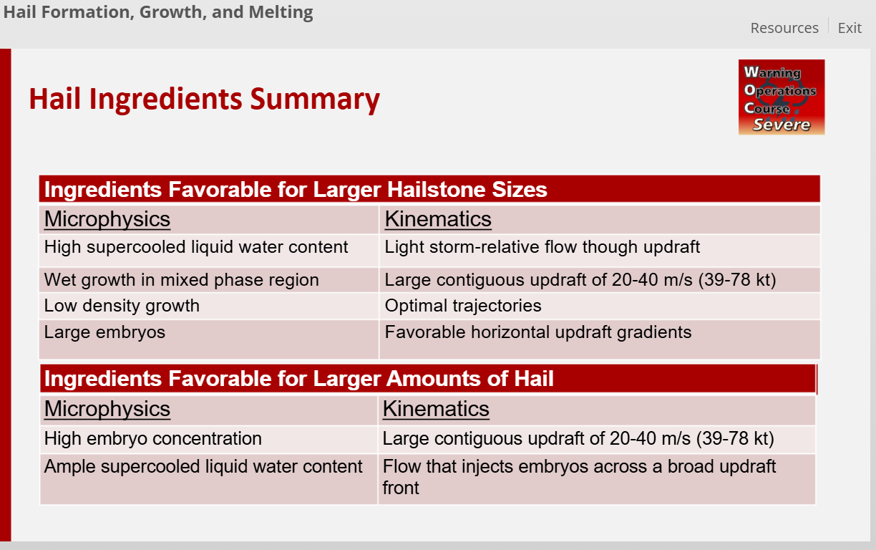

Slide 10
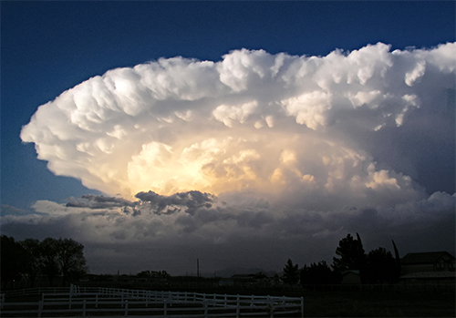
Basic ingredients for Hail and Significant Hail (Updrafts)
The largest contributors to the development of severe hail are strong convective updrafts
Best way to get strong updrafts?
  Lots of ways but having more CAPE helps a lot!
  Bigger CAPE (with some caveats) = stronger updrafts WMAX= √(2 x CAPE)
  Wider updrafts (stronger storm relative inflow) can be stronger and longer-lived
Strong vertical shear supports stronger and longer lived updrafts
  Storm organization (downdraft separation)
  Stronger storm relative flow (kinetic energy)
  Dynamical effects and pressure perturbations (More on this later!)

Slide 11
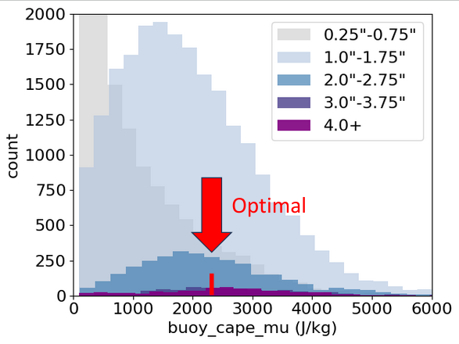
But a word of caution…
More CAPE does not always mean larger hail!
Simulations have found CAPE between 2000-2400 J/kg to be “optimal”
Giant hail is occasionally recorded with CAPE <1000 J/kg
Stronger shear can make up for this
Why?
  Higher cape environments are less common.
  measurement bias
  ect.

Slide 12
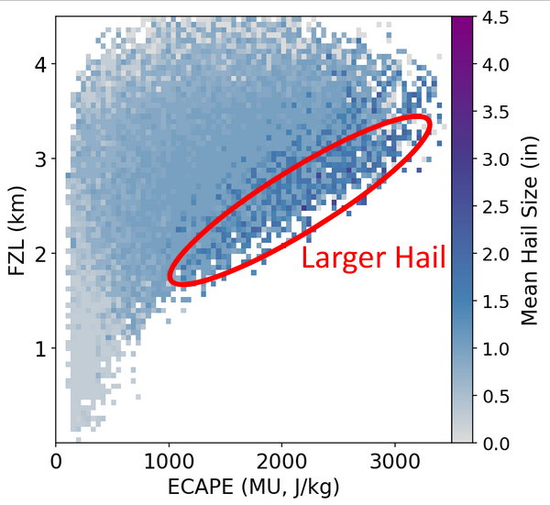
The Freezing Level and Hail
Hail potential is intrinsically related to the freezing level
Steeper lapse rates contribute to more CAPE and can support stronger updrafts.
Large hail is more likely with lower freezing levels for any CAPE
Steeper lapse rates can also mean lower freezing levels as temperature decreases more quickly with height.
Higher elevation locations are closer to the freezing layer and closer to EML source
Large to very large hail is more common in high mid-level lapse rate environments. Hence the climatology downstream of the EML source region.

Slide 13
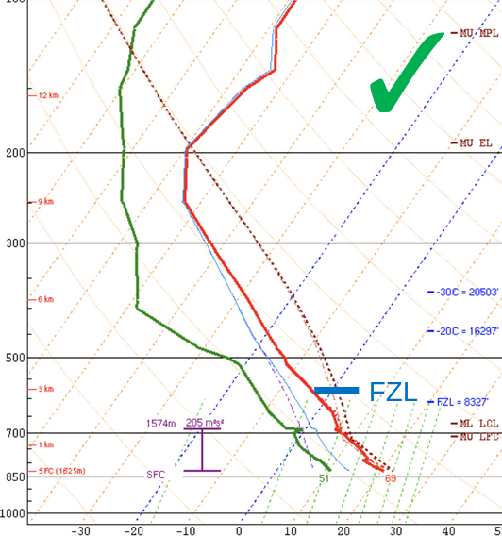
Lapse rates and Hail
Generally, we want a greater portion of CAPE above the freezing level
Steep lapse rates help achieve this!
Steeper lapse rates contribute to more CAPE and can support stronger updrafts.
Steeper lapse rates can also mean lower freezing levels as temperature decreases more quickly with height.
Higher elevation locations are closer to the freezing layer and closer to EML source

Slide 14
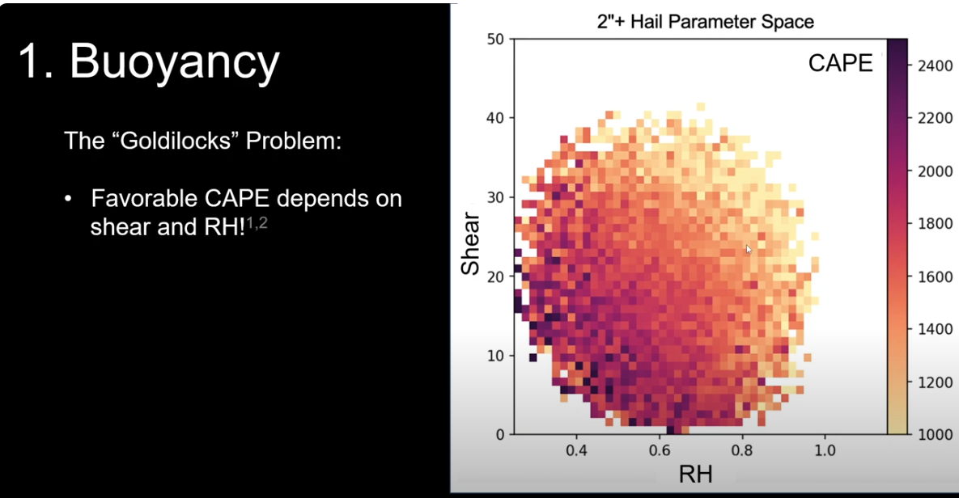
(Nixon & Allen 2023)

Slide 15
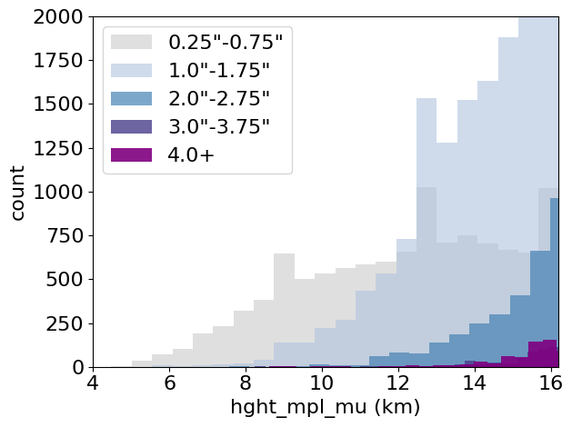
2. Storm depth
MPL is a good indicator of
the ceiling for hail size!
.25″
1″
2″
4″
(Nixon 2025)

Slide 16
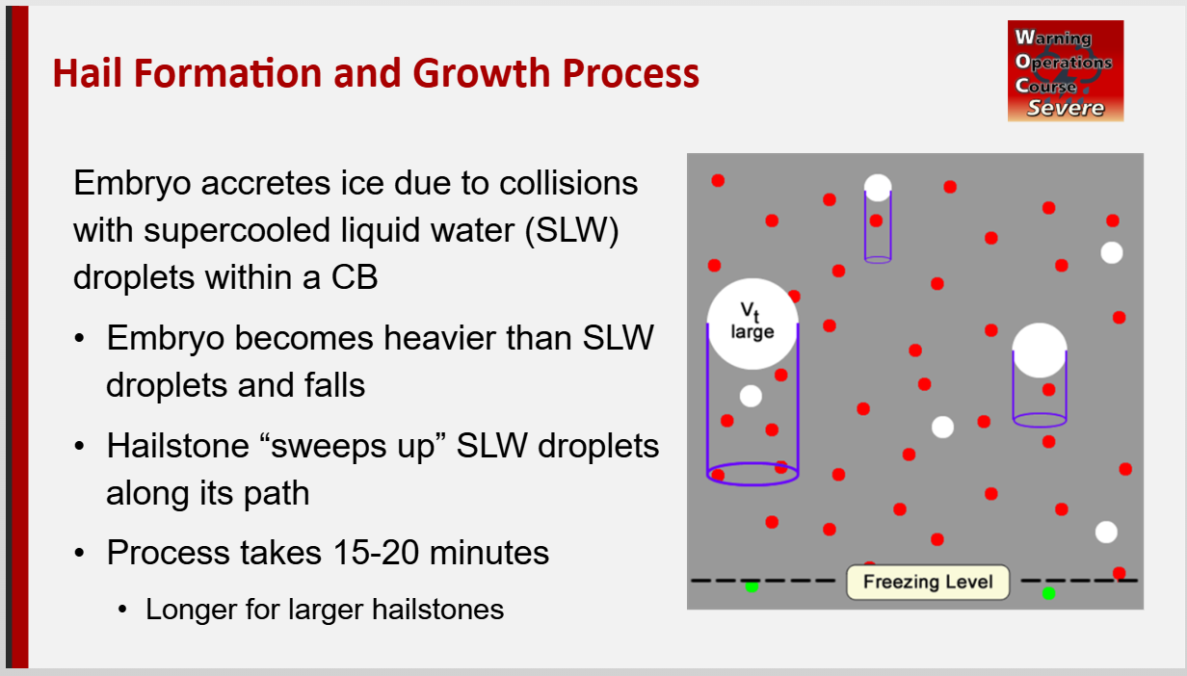
Hail Forecasting Saturation
Hailstone formation and growth requires enough supercooled water to support accretion.
Goldilocks problem. Need enough water to support formation and growth, but not too much
  Water-loading of the updraft
  Too much latent heat raises the freezing level and causes more water release from rain
  Too saturated also weakens lapse rates
Too little saturation in the mid-levels can weaken updrafts via dry air entrainment.

Slide 17

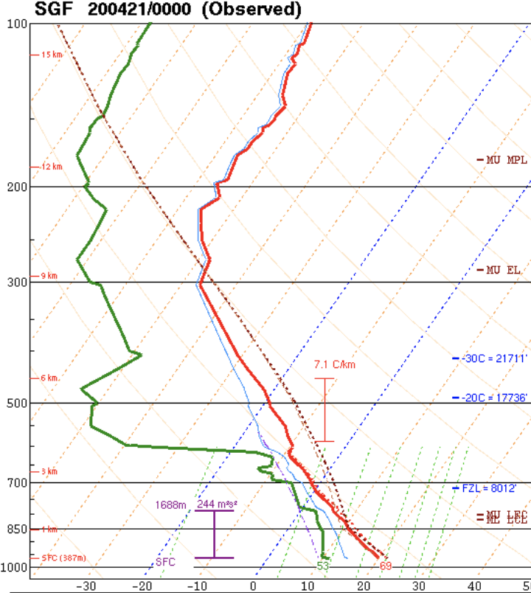
✓
2. Temp/Humidity
Cloud microphysics:
Colder, drier clouds produce
smaller droplets
More droplets are lighter, and can be
lofted higher, into colder temperatures
More droplets can go towards graupel
and supercooled water

Slide 18
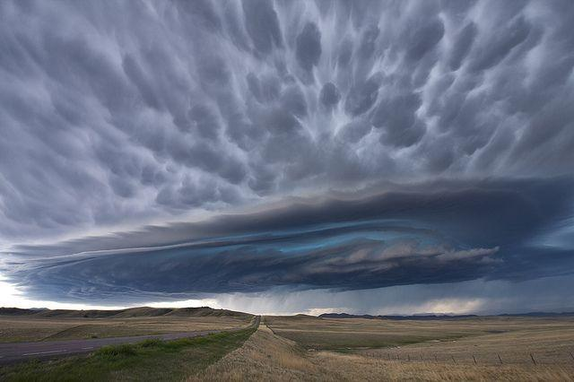
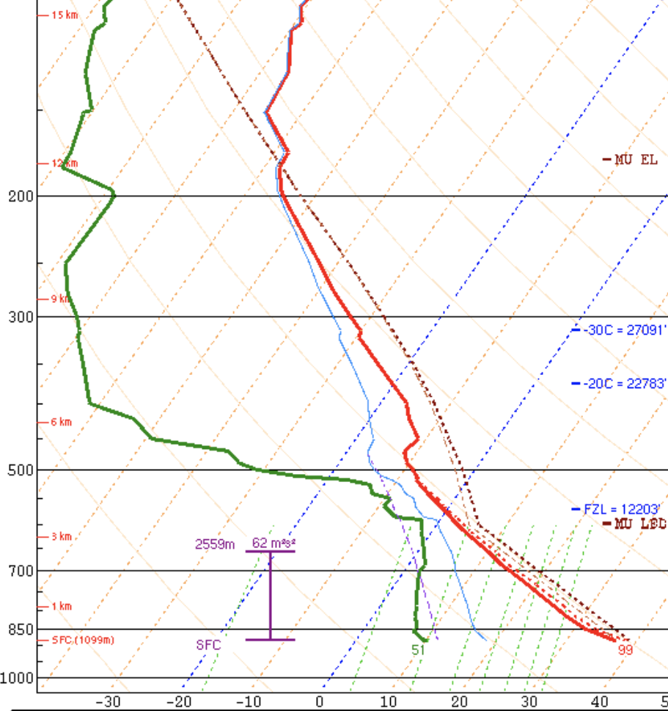
high-based
Summary:
Many ways to get efficient hailstorms:
Low freezing level
High elevation
Elevated inflow base
High cloud base
FZL

Slide 19
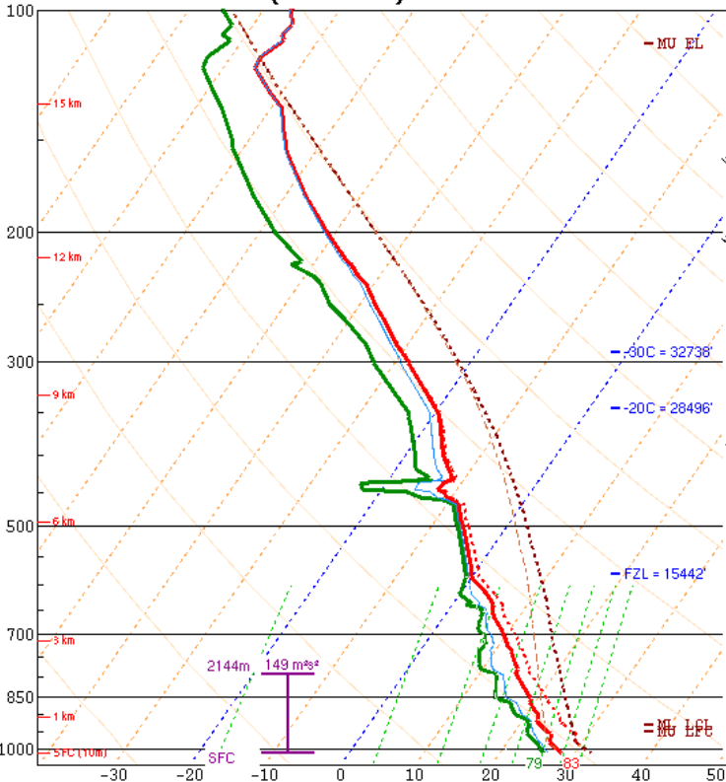
X
Summary:
Hail efficiency is poor with:
Deep, warm, moist inflow layer
High freezing level
Low elevation / tropical
FZL

Slide 20
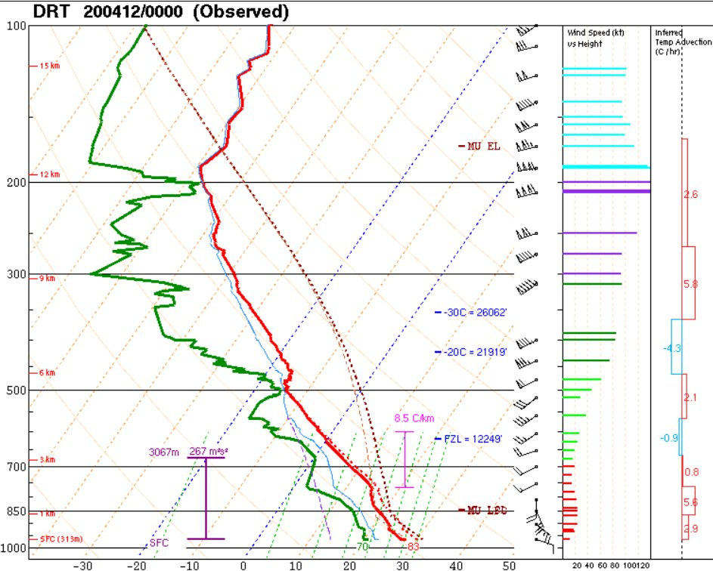
Hail forecasting with Skew-Ts
Large CAPE in the hail growth zone supports strong updrafts and residence time below freezing. (-10 to -30 C)
Steep mid-level lapse rates favorable for more cape, lower FZ Level
Low FZ Level or WBZ height also supports more time below freezing.
High Equilibrium height favors deeper updrafts.
EL HGT
HGZ
WBZ hgt

Slide 21
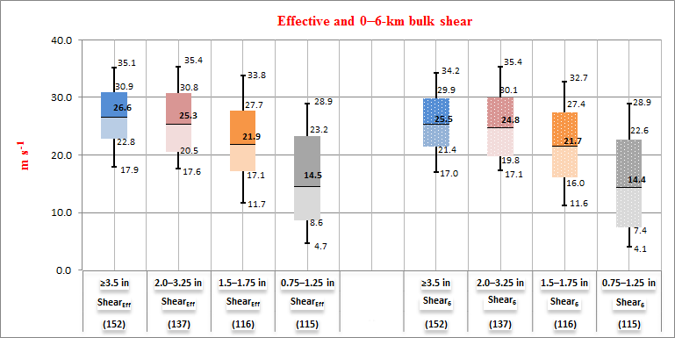
Vertical Shear
(Johnson & Sugden 2021)

Slide 22
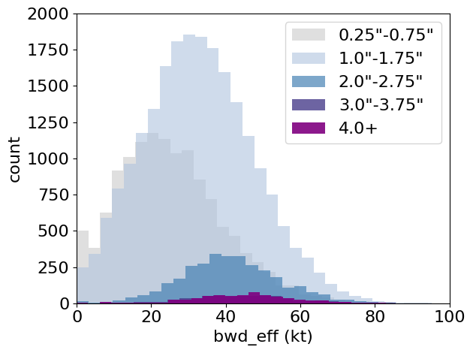
4. Wind Shear
Effective shear/SRW is most skillful,
likely because many hailstorms
are elevated¹
SHIP/LHP do not take this into
account!
1 – Nixon & Allen (2023)

Slide 23
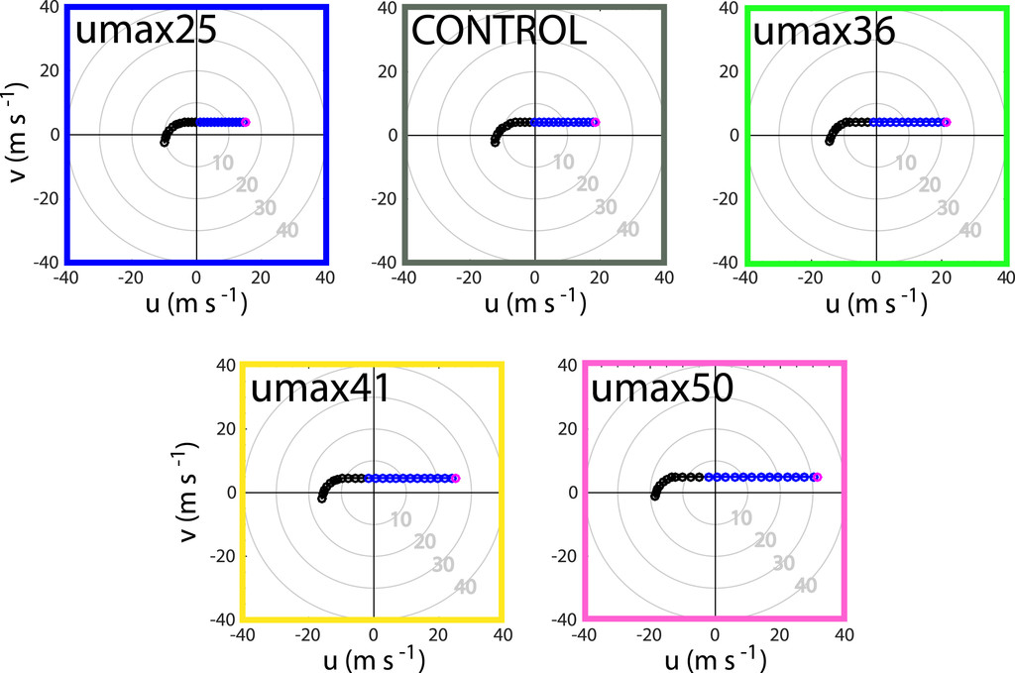
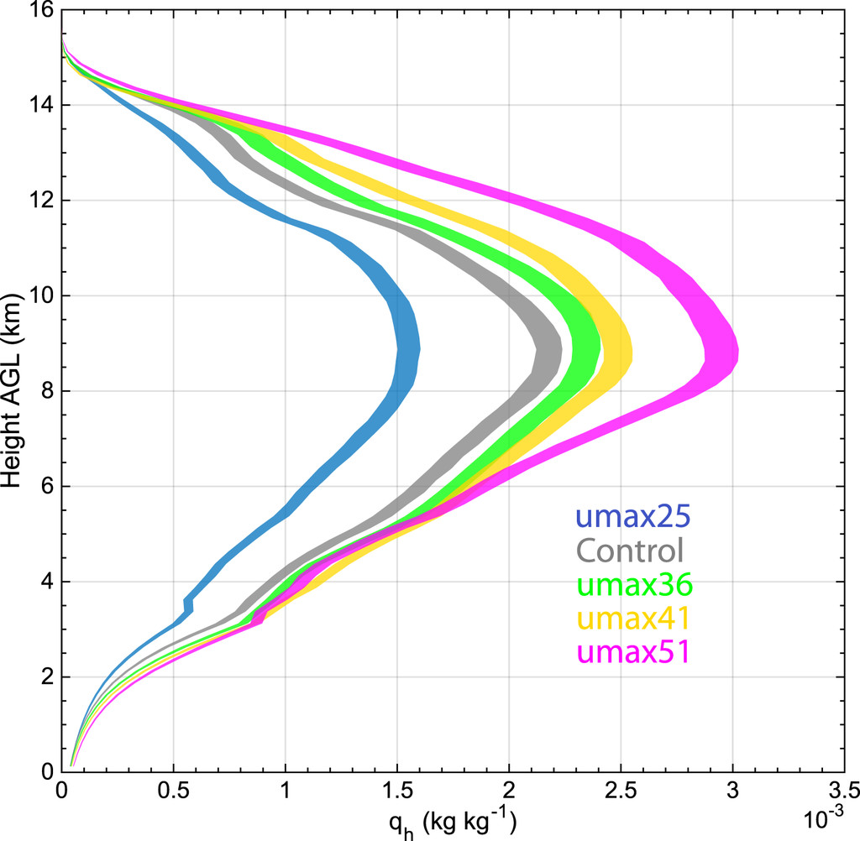
4. Wind Shear
Stronger deep-layer shear can support
wider updrafts that produce more hail^{1,2}
More hail mass
1 – Dennis & Kumjian (2017)
2 – Nixon et al. (2023)

Slide 24
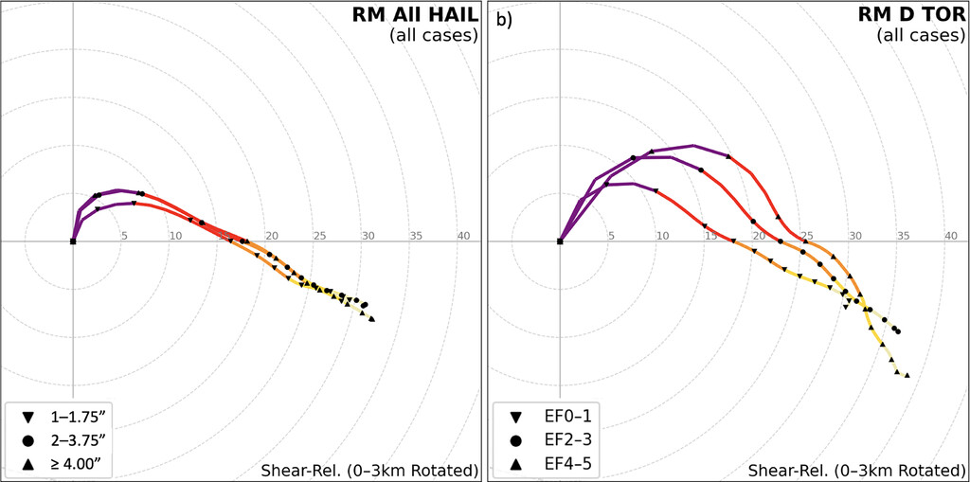
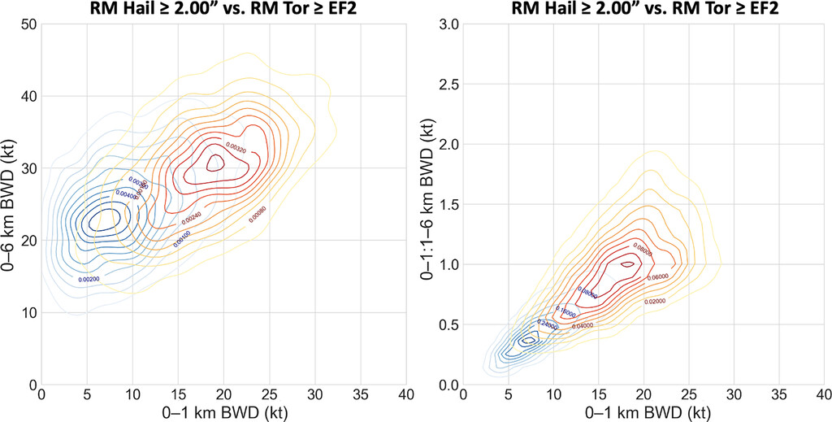
Hail Favoring Hodographs
(Nixon & Allen 2022)
Moderate to strong mid-level shear
Upper-level flow not too strong to limit residence time.
Strong enough low-level SRW to support broad updraft and supercells.
But not too strong to displace hail embryos.
Weaker low-level shear compared to tornadic cases but still significant overlap.
Cool stable layer at the surface
Effective straight line hodo aloft

Slide 25
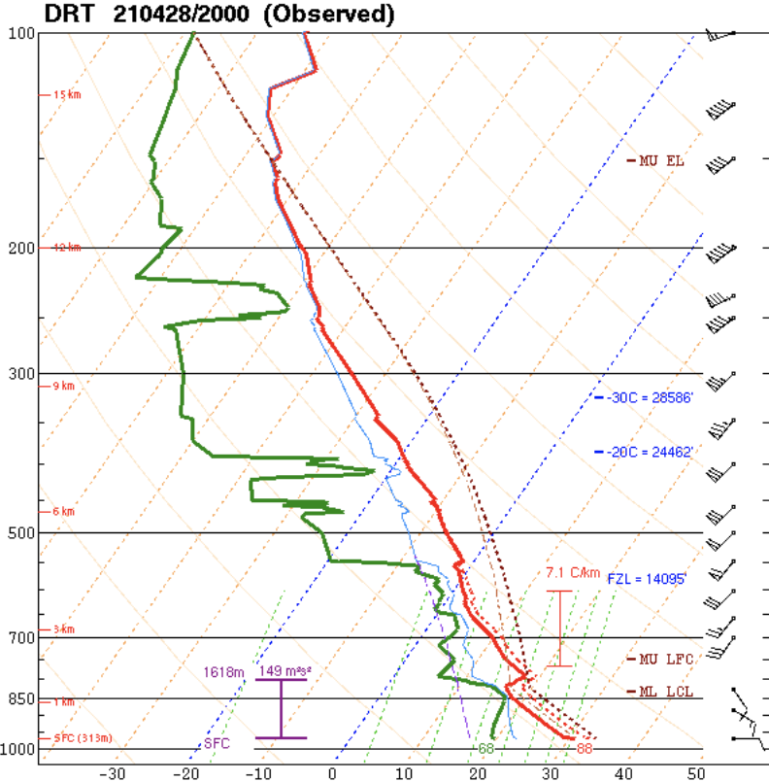
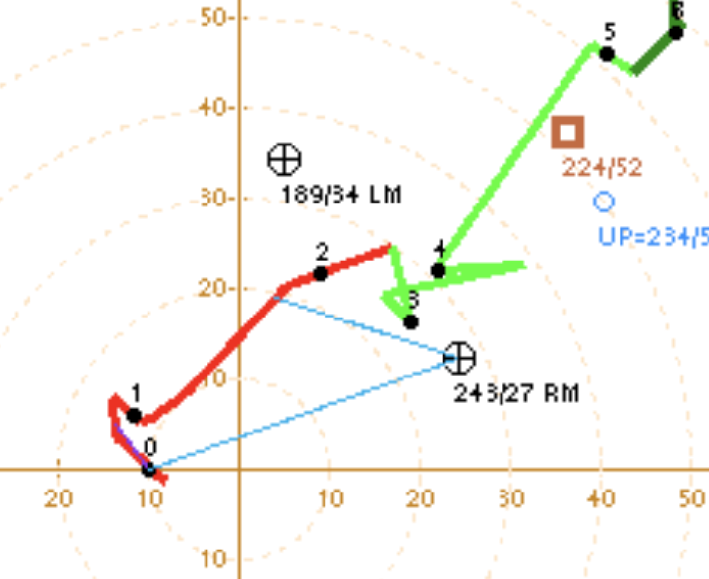
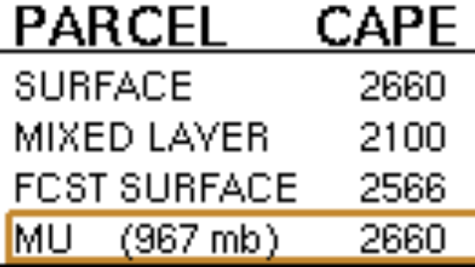
Summary:
MPL^
How to get the largest hailstones:
Moderate CAPE
Higher MPL
Stronger Eff. Shear

Slide 26
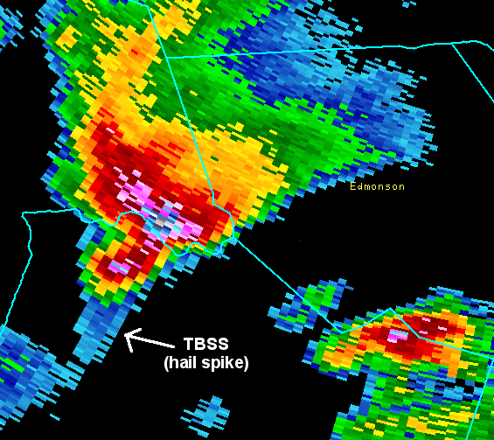
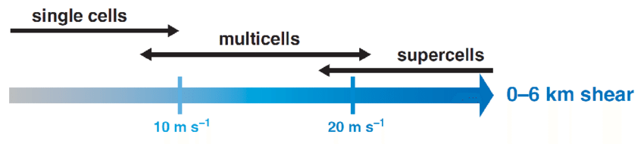
Updrafts (Storm Mode)
The majority of prolific hail events are produced by supercells.
Storm mode plays a significant role. Hail more likely with discrete or cluster types. Less likely with lines.
Vertical shear strong enough to supports supercells can be a significant predictor for hail.
Storm interactions can also favor hail.
Splitting storms and left movers.

Slide 27
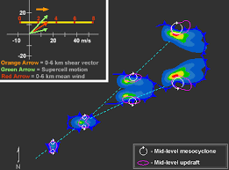
Splitting Supercells
Relatively straight hodographs that favor splitting supercells can produce large hail.
Left split storms can be dynamically suppressed by vertical shear favorable for RM.
  Less favorable for tornadoes
  But still strong enough updraft to produce large hail.
Splitting storms can occur near boundaries with elevated features.

Slide 28
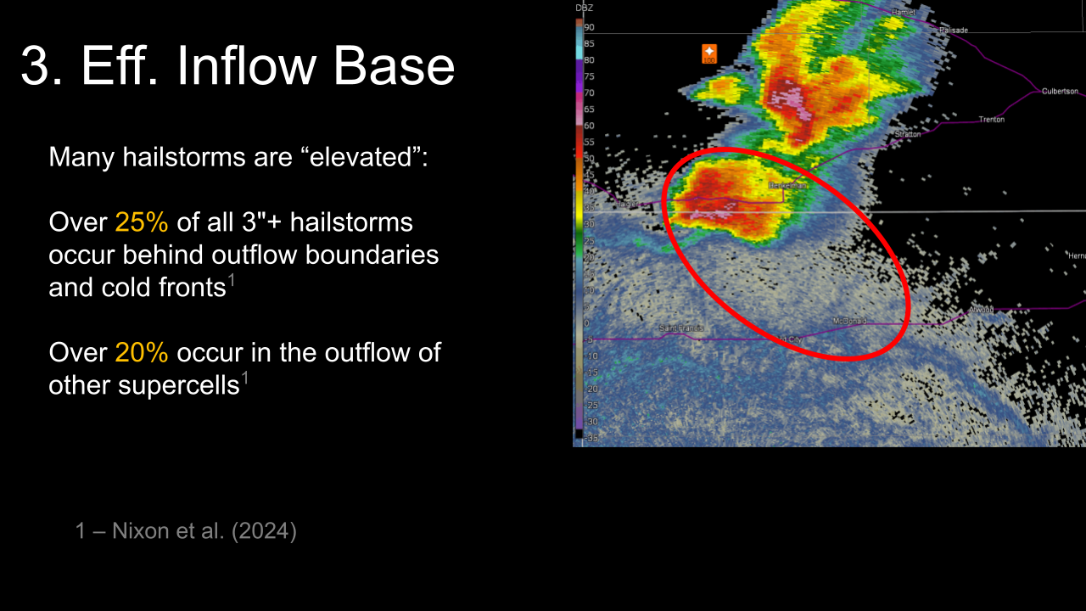

Slide 29
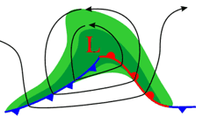
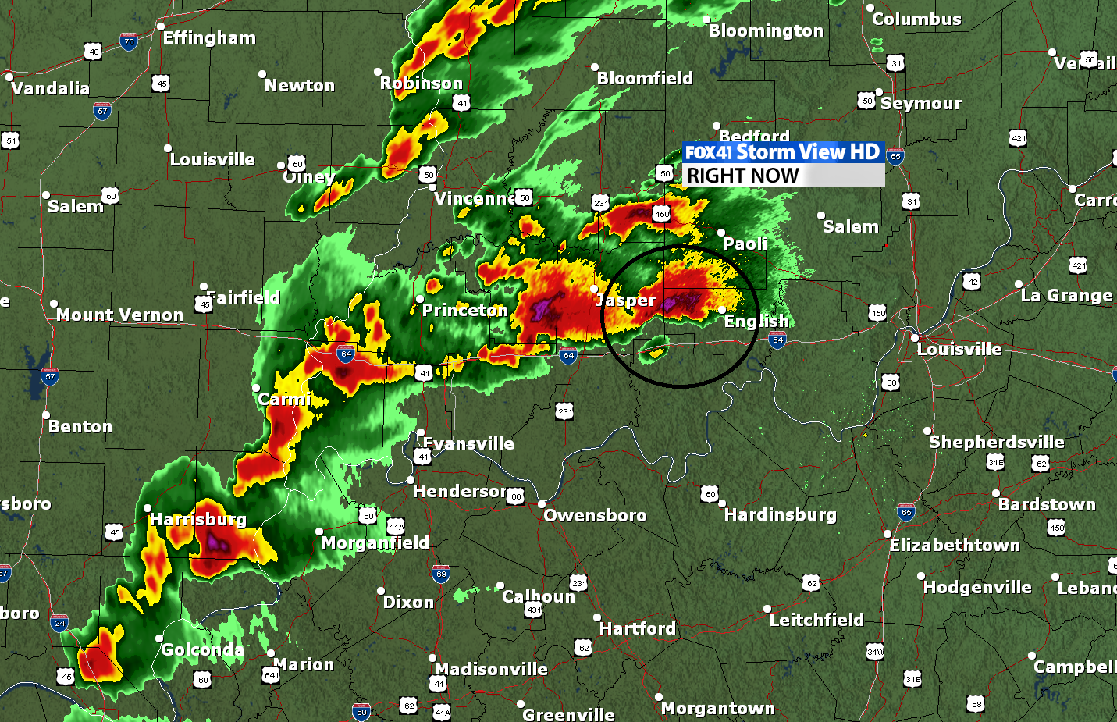
Setups Favoring Hail (Warm Front)
Elevated supercells within WAA
Elevated CAPE Strong effective shear but stable at the surface
Very classic setup for large hail along and north of the WF

Slide 30
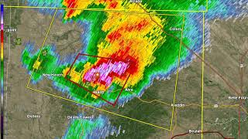
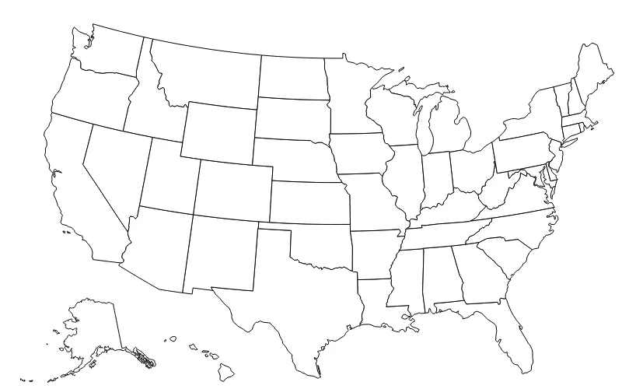
Setups Favoring Hail (Stationary Front/Northwest Flow)
L
Common over the High Plains
Cool but unstable air to the north favors elevated storms.
Can precede sig wind events.

Slide 31
Setups Favoring Hail (Dryline/Warm sector)
Initial splitting supercells off the dryline and north into outflow or upslope behind the low.
Hail very common with the initial development stages of supercells off the dryline
Possible even into cooler air or wrap around upslope into the high plains.
Warmer temperatures farther south force higher-based storms
Hail threat still possible farther east with strong supercells.
L
Outflow
Weaker low-level shear but large CAPE and mid-level shear high-based supercells

Slide 32
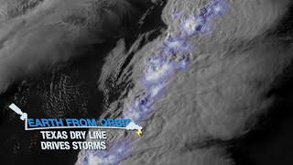

Slide 33
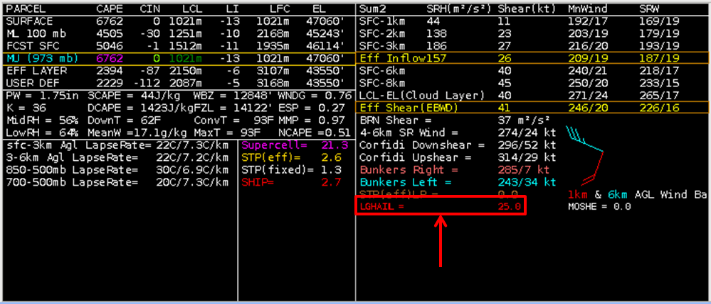
Hail Parameters
If if 0-6 km BWD < 14 m s ⁻¹ or MUCAPE < 400 J kg⁻¹, LHP = 0. If both the shear and MUCAPE are >= to the above conditions (a loose supercell check):
LHP = (TERM A * TERM B) + 5
TERM A = (((MUCAPE-2000)/1000) + ((3200-THK_{HGZ})/500) + ((LR₇₅-6.5)/2)) where THK_{HGZ} is the depth of the hail growth zone (the -10 to -30 C layer), and LR₇₅ is the 700-500 mb temperature lapse rate.
TERM B = (((Shear_{EL}-25)/5) + ((GRW_{dirEL}+5)/20) + ((SRW_{dirMID}-80)/10)) where Shear_{EL} is the magnitude of the vector wind difference between the surface wind and the mean wind in the 1.5 km layer immediately below the EL height for the MU parcel, GRW_{dirEL} is the directional difference between the ground-relative mean wind in the 1.5 km layer below the EL and the mean wind in the 3-6 km layer AGL, and SRW_{dirMID} is the directional difference betweem the mean storm-relative winds in the 3-6 km and 0-1 km layers.
Large Hail Parameter
A multiple ingredient, composite index that includes three thermodynamic components [MUCAPE, 700-500 mb lapse rates, the depth of the hail growth zone (-10 to -30 C)], as well as three vertical shear components [surface to EL bulk shear, the direction difference between the ground-relative winds at the EL and in the 3-6 km layer, and the direction difference between the storm-relative winds in the 3-6 km and 0-1 km layers].
STP for hail

Slide 34
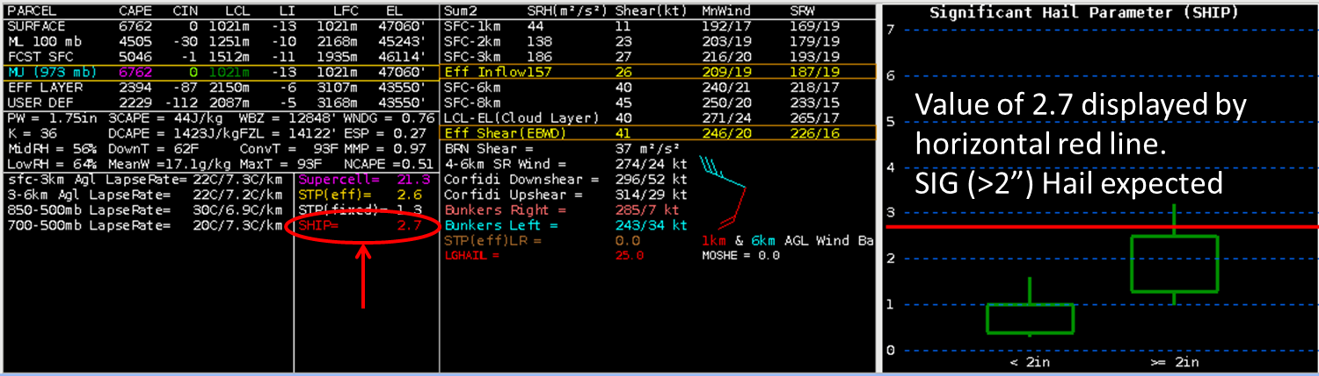
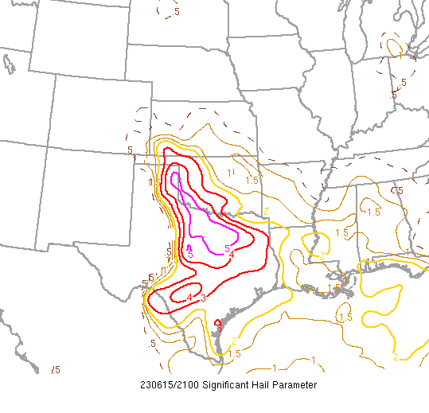
Hail Parameters
Significant Hail Parameter
The Sig. Hail Parameter (SHIP) was developed using a large database of surface-modified, observed severe hail proximity soundings. It is based on 5 parameters, and is meant to delineate between SIG (>=2" diameter) and NON-SIG (<2" diameter) hail environments.
SHIP = [(MUCAPE j/kg) * (Mixing Ratio of MU PARCEL g/kg) * (700-500mb LAPSE RATE c/km) * (-500mb TEMP C) * (0-6km Shear m/s) ] / 42,000,000

Slide 35
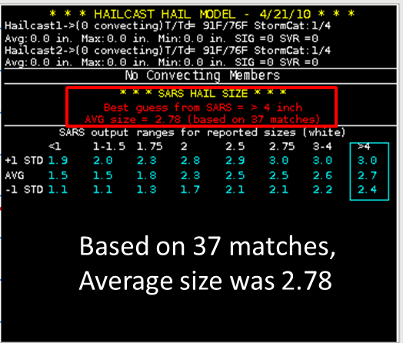
Hail Parameters
SARS Hail Size
The SARS method returns a maximum expected hail report by matching existing environmental conditions to historic severe hail cases. These forecast maximum sizes are conditional on severe hail of any size occurring.
This graphic shows the "best guess" maximum hail report.
Hailcast is a 1D model developed by SPC forecaster ryan Jewel to estimate the maximum hail size based on a supplied model or observed sounding.

Slide 36
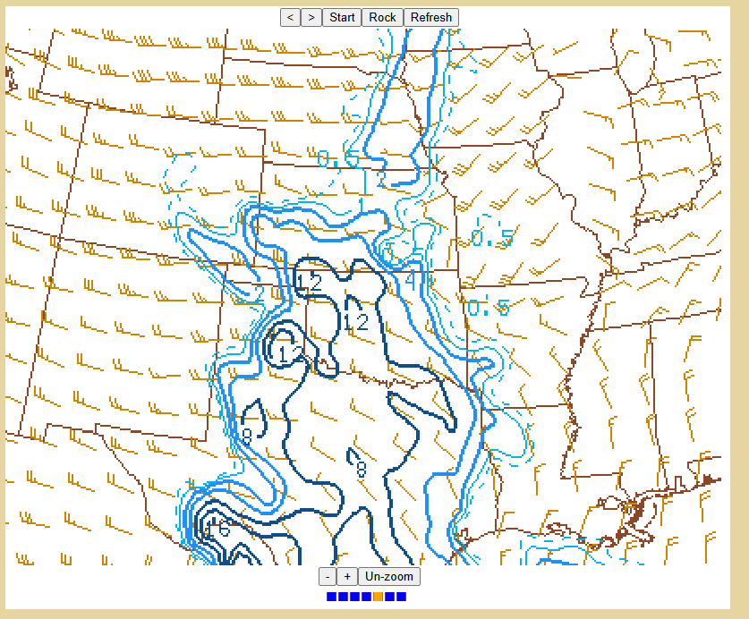
Hail Parameters
Supercell Composite Parameter
A multiple ingredient, composite index that includes effective storm-relative helicity (ESRH, based on Bunkers right supercell motion), most unstable parcel CAPE (muCAPE) and convective inhibition (muCIN), and effective bulk wind difference (EBWD). Each ingredient is normalized to supercell "threshold" values, and larger values of SCP denote greater "overlap" in the three supercell ingredients. Only positive values of SCP are displayed, which correspond to environments favoring right-moving (cyclonic) supercells.
SCP = (muCAPE / 1000 J kg⁻¹) * (ESRH / 50 m² s⁻²) * (EBWD / 20 m s⁻¹) * (-40 J kg⁻¹ / muCIN)
EBWD is divided by 20 m s⁻¹ in the range of 10-20 m s⁻¹. EBWD less than 10 m s⁻¹is set to zero, and EBWD greater than 20 m s⁻¹ is set to one. The muCIN term is based on work by Gropp and Davenport (2018), and it is set to 1.0 when muCIN is greater than -40 kg⁻¹.
Not a direct hail forecast but can be useful.

Slide 37
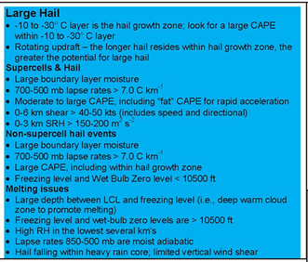
Hail Forecasting Cheat Sheet

Slide 38
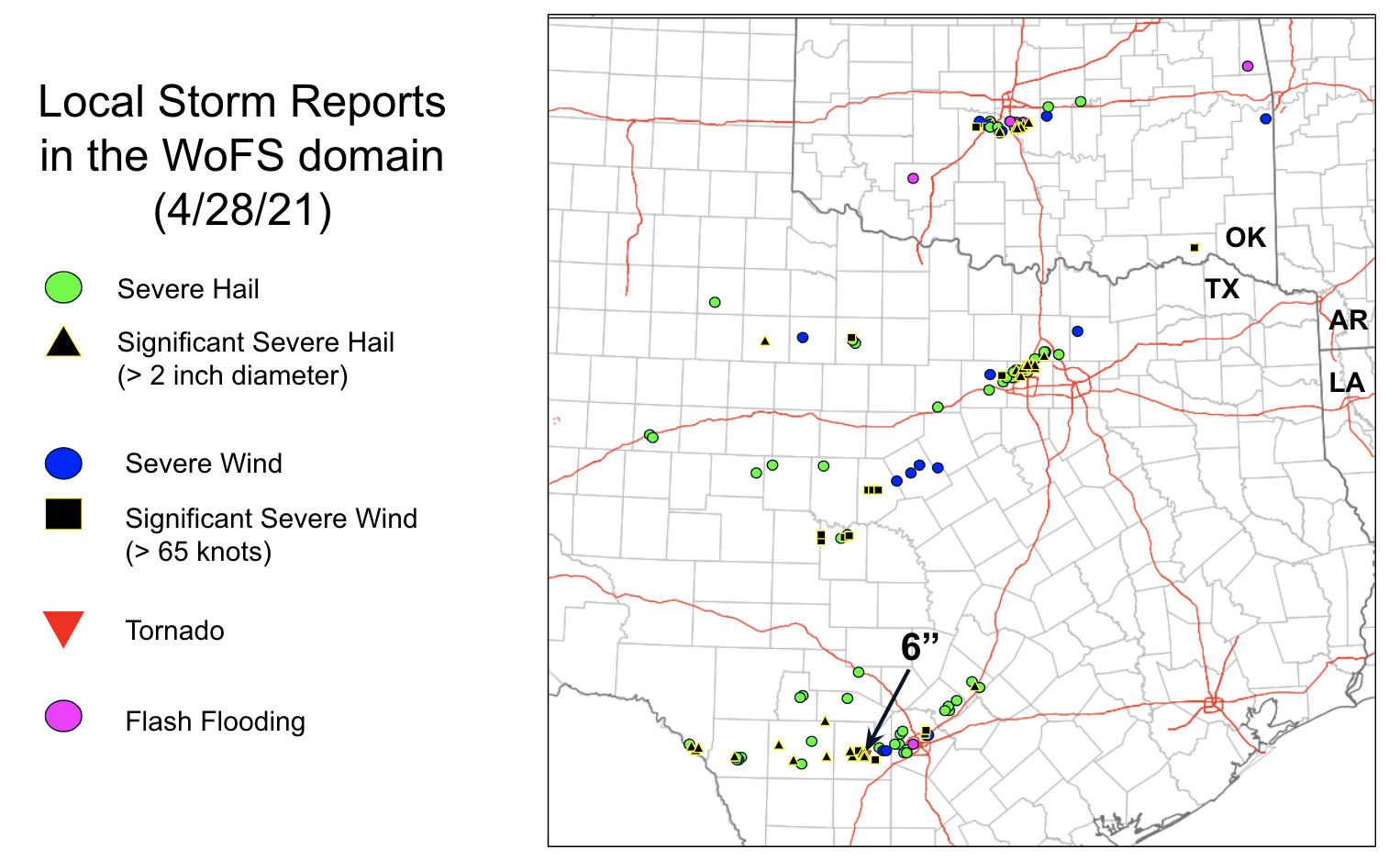



April 28 2021 Norman Hail Storm
Swath of 2-2.75 inch hail through Norman. Including my house…
Millions in damage thousands of cars dented.
Not overly well forecast
Audible hail roar!

Slide 39



Slide 40


Slide 41


Slide 42

Storm was potentially elevated!
OUN sounding missing I wonder why :)

Slide 43


Slide 44



May 16, 2010 OKC Hail Storm
Significant spring hail storm over parts of the southern Plains.
A relatively benign pattern without strong surface features but still supported giant hail.

Slide 45


Slide 46


Slide 47


Warming would support moderate CAPE with moderate deep-layer shear
Probable supercell storm mode.
Supercells can produce extremely large hail

Slide 48

Storm was elevated north of the front!!

Slide 49


EFFECTIVE SHEAR
SBCAPE

Slide 50

May 8, 2017 Denver Hail Storm
$2.3 Billion dollars in damage through the heart of downtown Denver.
Several elevated supercells north of a stationary front.
Numerous reports of golf ball and 2 inch wind driven hail.

Slide 51


Slide 52



